Slide 1
COMMUNICATION SKILLS II

Slide 2
Basic Definition
Communication is an activity or process of expressing ideas and feelings or of giving people information.
Latin word ‘communicare’ which means ‘To share’ i.e. to share information, knowledge, ideas between a sender and a receiver.

Slide 3
INTRODUCTION
We encounter various situations involving speech or writing: conversation with friends, professors, or colleagues to achieve various purposes; seminars, group discussions, written tests, and examinations; and laboratory or project report submissions on diverse topics. Likewise, at the workplace, we interact with superiors and subordinates, converse with them face-to-face or over the telephone, and read and write emails, letters, reports, and proposals. All these activities have a common denominator—the sharing of information.
When one becomes a part of any organization, one needs to communicate, and communicate effectively. No organization can survive without communication.

Slide 4
Importance of communication/ Technical Communication
Central role, survival, professional organizations, avoiding misunderstandings, good relations etc.
Technical Communication – Global era so effective transfer of documents, discussions etc. which reflects public face for organization their policies, achievements.
Engineers - Technical skills + Subject knowledge + English language skills.
Employability Versus Job specific skills

Slide 5
Why English Language ?
Worldwide used so command over English is essential for operations that involve communicating with both national and international clients.
Business English, professional English, technical English
Interacting with customers, managing conflicts, negotiating, presenting ppts, proposals, drafting reports etc.
LSRW Skills
Knowing English < speaking English

Slide 6
Communication competence
Communication competence is the ability to express views in an effective manner, enabling one to achieve goals and enhance relationships.
Communication competence is situational. For example, a person may be very skillful in interacting with peers but less proficient in interacting with older or younger people.
To develop such competence, one must acquire the ability to choose the most appropriate behaviour in a given situation, because what is appropriate for one person may not be appropriate for another.

Slide 7
Communication as self concept
An individual's self-concept is the core of his personality.
It affects every aspect of human behavior: the ability, to learn, the capacity to grow and change. A strong, positive self-image is the best possible preparation for success in life.
Self-esteem is an important element of self-concept. People having high self-esteem communicate more openly.

Slide 8
Role of emotions
In professional interactions it is quite important to control our emotions in order to achieve the given objective.
To successfully communicate, you must respect the point of view of other people, especially those who are easily overpowered by emotions, during the conversation.
On the other hand, if one is too emotional, it is very important to learn how to control emotions and not let them interfere in rational decision-making.

Slide 9
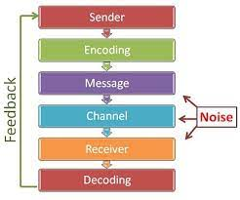
Structure Model of Communication

Slide 10
Communication process
The first step is formulation, wherein the sender forms the content of the message to be sent. This formulation depends on the level of experience, intelligence, knowledge, and purpose of the sender. The content, once formed, is called the message. The sender encodes the message using a basic tool. This tool is nothing but the language used—words, actions, signs, objects, or a combination of these. Once encoded using proper language, the message is ready to be delivered.
This delivery happens through channels or media of communication. It can be face-to-face, on paper, or through electronic or digital media such as the Internet. The receiver receives the message, decodes it, and acts on it. If the message received is the same as the message sent, there will be an appropriate response; if not, there will still be a response, but probably an inappropriate or unexpected one, as there has been a breakdown or interference in the communication.

Slide 11
Conti.
The transmission of the receiver’s response to the sender is called feedback. Feedback is essential, as it measures the effectiveness of communication. When a message is sent, the communication cycle is complete only when there is a response from the recipient of the
message. Otherwise, the message needs to be re-sent. When a response is received, the message has been successfully delivered to the other party.

Slide 12
Purpose and Audience
Why I am communicating ?
Need to inform, to persuade, to entertain, to train or to sell
General or specific ( desired outcome )
Prior knowledge about audience - size, position, knowledge, attitude, preferences.
Realistic and clear in our purpose e.g.. Ms Excel

Slide 13
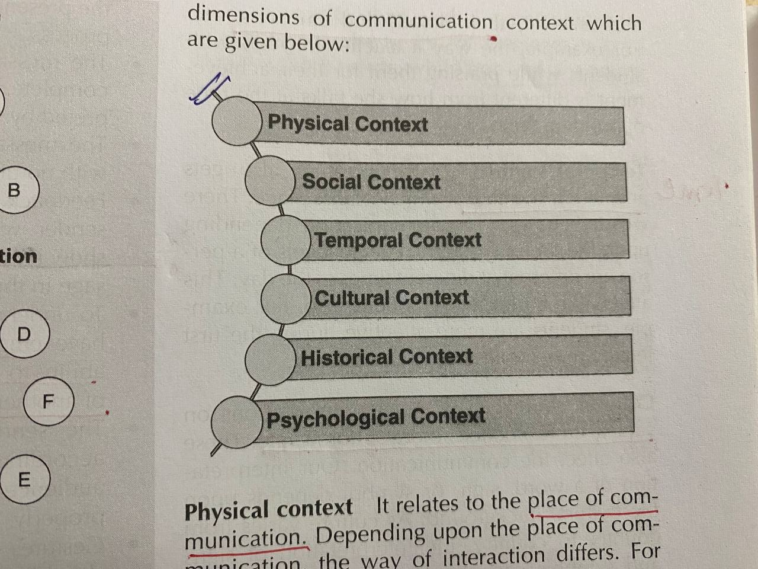
Communication context

Slide 14
Cross cultural communication
Culture is a complex concept, with a variety of definitions. The dictionary meaning of the word 'culture' is a group or community with which we share common experiences that shape the way we understand the world. It consists of groups that we are born into, such as gender, race, or national origin, etc. It also includes groups we join or become part of, or the new habits we acquire as we interact with different people.
Language, Religion and beliefs, values, politics and law, social organization.

Slide 15
Communication has its roots in the Latin word “communis” which means ‘common’. Keith Davis, in his book, Human behaviour at Work, defines: “Communication is the transfer of information and understanding from one person to another person”
Communication is a two-sided affair that involves not only the sending of messages, but also includes their receiving. Hence, communication can be called the process of sharing or exchange of feelings, emotions, ideas or information. Both the sender as well as receiver of the message equally participate in the process.

Slide 16
Classification of communication
One way communication
Sender –message-receiver
The sender transmits a message through words, signs, symbols or body movements, and the receiver receives the message as well as interprets its indented meaning. When the sender communications a message without expecting or getting feedback, the communication is termed as one-way communication. Feedback is totally absent in this kind of communication. Listening of a recorded song is an example of one-way communication .

Slide 17
Two way communication
Two-way communication
Sender-message-receiver-feedback
Communication involves the sending of a message and receiving of its feedback. The sender transmits a message, and the receiver conveys feedback of the message to the sender. In case of feedback, the receiver acts as a sender, and the sender becomes receiver.

Slide 18
Importance of communication
1. Builds favourable relations.
2. facilitates organisational goals
3 effective communication-coordination

Slide 19
Essentials of effective communication
• A well-defined communication environment
• Cooperation between the sender and the receiver
• Selection of an appropriate channel
• Correct encoding and decoding of the message
• Feedback

Slide 20
Assertive Communication
Assertive communication is the ability to convey ideas and information in an uninhibited, clear, and direct way.
It is often mistaken as aggression, but there is a fine line between the two. Being aggressive means to oppose with force, whereas, being assertive means to be able to present one's view point with appropriate reasoning.
Example- Group discussion

Slide 21
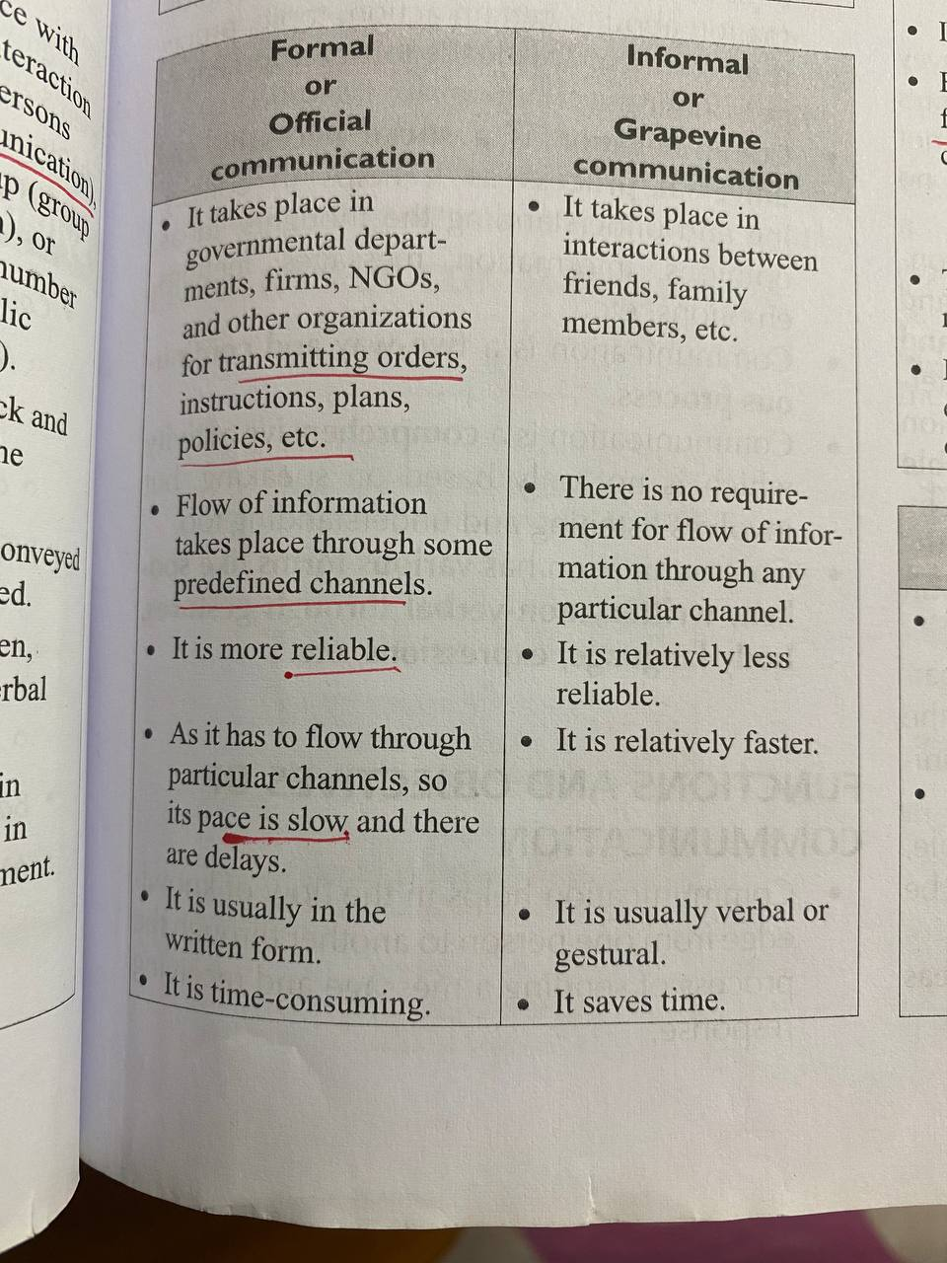
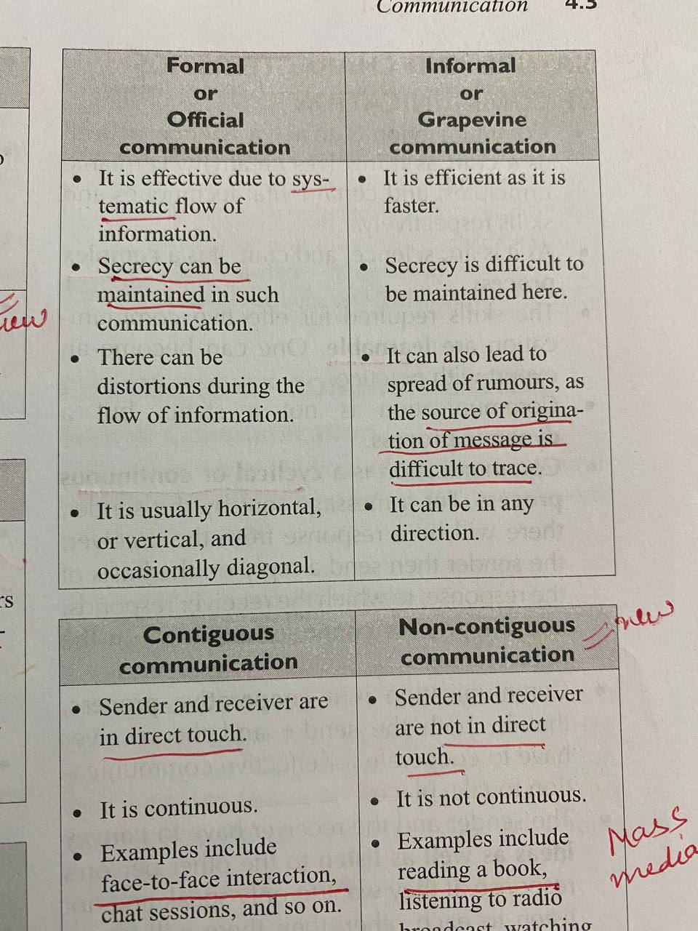
Formal and informal communication

Slide 22
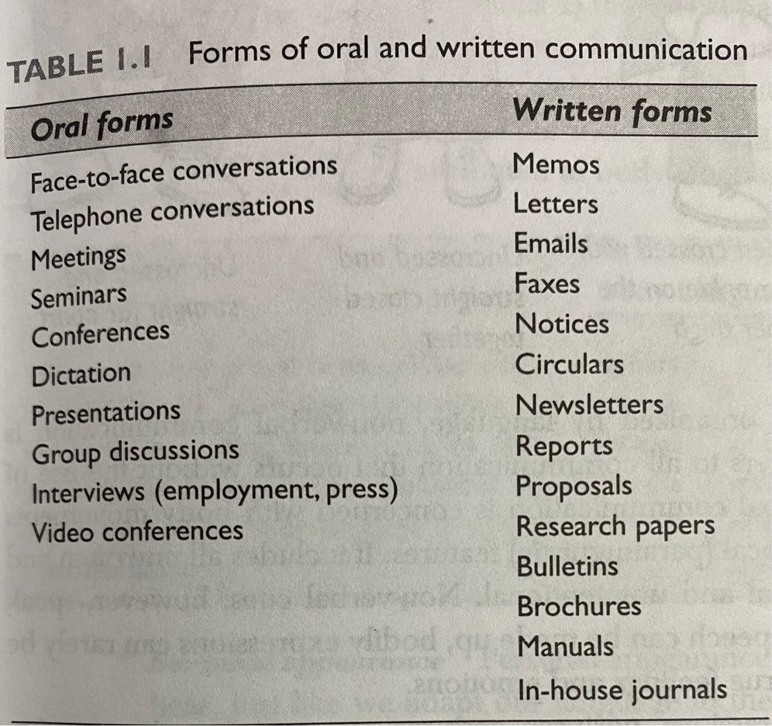
Oral and written

Slide 23
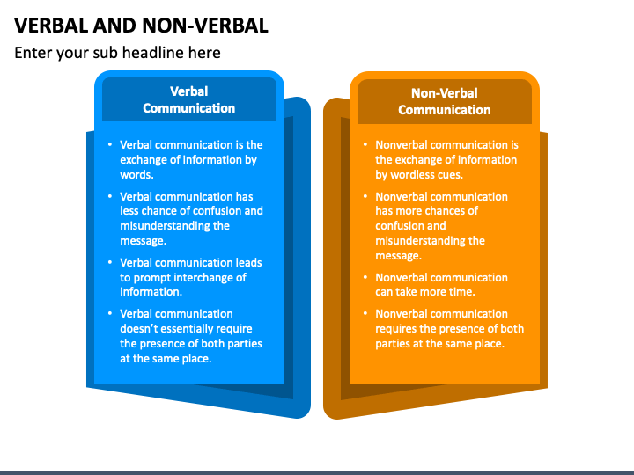
Verbal and non verbal

Slide 24
DIFFERENCE BETWEEN GENERAL AND TECHNICAL COMMUNICATION
GENERAL COMMUNICATION
• Contains a general message
TECHNICAL COMMUNICATION
• Contains a technical message
• Informal in style and approach.
• No set pattern of communication.
• Mostly oral.
• Not always for a specific audience.
• Does not involve the use of technical vocabulary or
graphics, etc.
• Mostly formal
• Follows a set pattern
• Both oral and written
• Always for a specific audience
• Frequently involves jargon, graphics, etc.

Slide 25
Technical communication
Technical communication usually has the following objectives:
To provide organized information that aids in quick decision-making
To invite corporate joint ventures
To disseminate knowledge in oral or written form

